Slide 1
Opinions in a Social Network
Stochastic Modelling of a Binary Opinion with Differing Levels of Involvement
Joseph Gilby, MATH 111A

Slide 2
Introduction
Opinions can be divisive
Opinions organize communities
Differing involvement among individuals

Slide 3
Rundown of References
Agent Based Models
Ising Models (two states)
Strategy-based

Slide 4
Observation (Ising):
Why not more opinion states?
Differing levels of involvement?

Slide 5
Goals
Suppose a (stochastic) model
Demonstrate efficacy
Monte Carlo simulations
Goal: ‘Silent majority’ scenario

Slide 6
The Model: Social Network
Social Network Graph (undirected)
Binary Opinion (A or B)
Each node takes on 1 of 5 states:
Strongly Opinionated A
Leaning A
Neutral
Leaning B
Strongly Opinionated B

Slide 7
The Model: Markov Model
Initial configuration node states at
Time step to , each action depends on node state
Chance node will transmit to all neighboring nodes
Receive transmission: chance of changing state

Slide 8
The Model: Markov Model
Receiving transmissions: transition matrices
One for each opinion type
Remark about receiving multiple transmissions
Sum of delta transitions

Slide 9
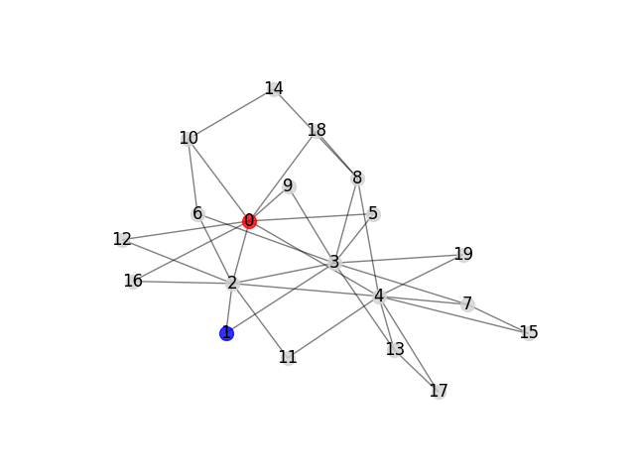
step 2

Slide 10
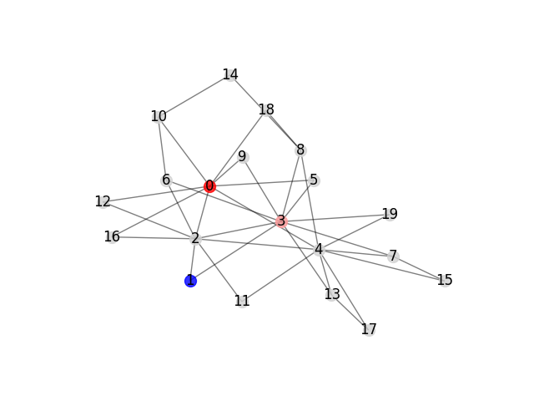
step 4

Slide 11
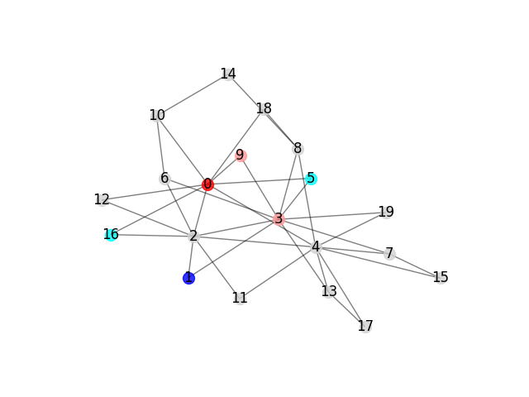
step 20

Slide 12
The Model²: Fill Out Probabilities
Want: to run Monte Carlo. Need: actual probabilities
Need to make assumptions
‘Similarity’ between transition matrices
Define some variables to generate probabilities
Neutral nodes do not send transmissions

Slide 13
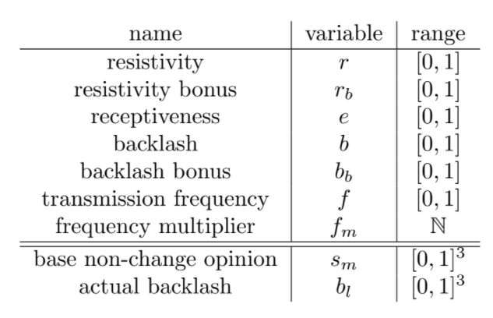
The Model²: The Variables

Slide 14
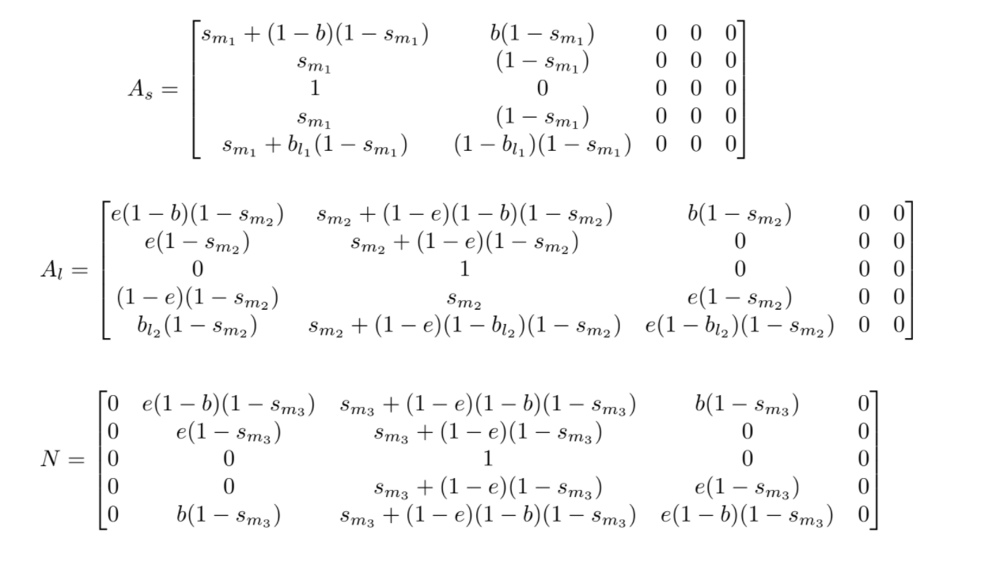

Slide 15


Running Monte Carlo Simulations
Fix
Then are ‘free’ parameters
Goal: Find parameters for silent majority

Slide 16
Results
Did find a ‘silent majority’ scenario
‘Convergence’ of time series
Some honesty: heuristics were used

Slide 17
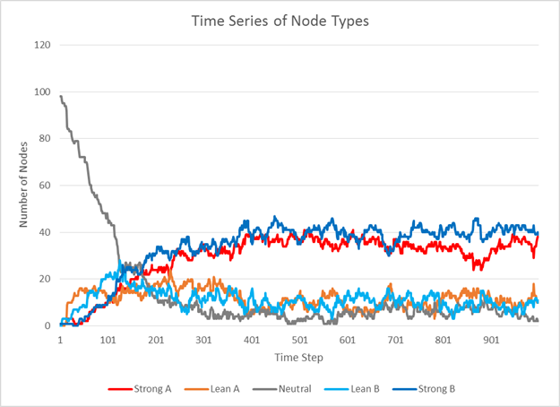
A ‘Typical’ Run

Slide 18

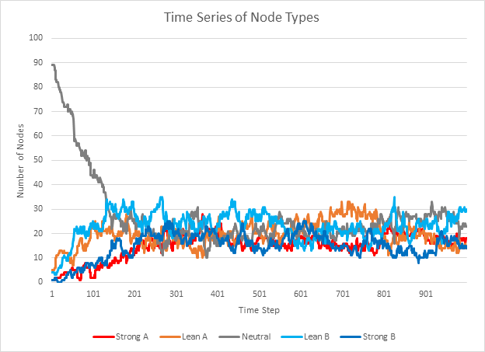
Based off a Lucky Run

Slide 19
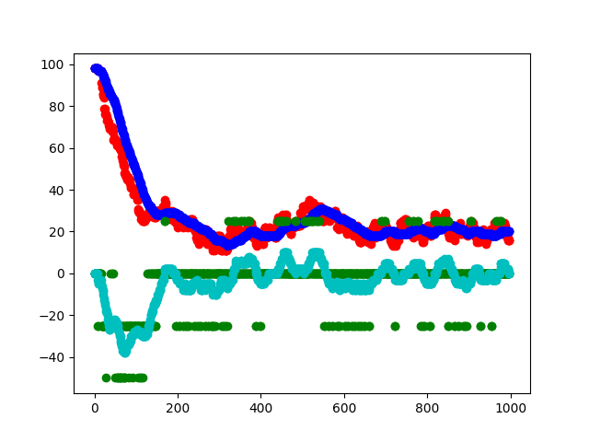

Slide 20
Conclusion
Model can both exhibit dominance of both silent majority or vocal majority
Model can be simulated using Monte Carlo Method
Somewhat slow on a personal computer
Difficult to run optimization algorithms

Slide 21
Continuing Work on Model
Relax fixed connections assumption
Propose new probability interrelations
Reduce variance in time series
Parameter stability analysis
Real-world parameter estimation
Find more behaviors exhibited by model

